Slide 1




Slide 2

Software to manage your Petrol
Pump Including Complete
Accounting & inventory

Slide 3


Slide 4

    Flexible
  Interactive
  User friendly Software
Highly Compatible with windows (All Versions)
Available in Two version Standard & Professional

Slide 5
Main Features of Meu petrol
Meter Reading System
Shift System
Shift/ Daily Report
Sale of Miscellaneous Items Like Oil, Snacks & Water etc
Evaporation Handling
Handling of Sub Nozzle under Main Nozzle
Vehicle Watch Specail Alert System for the Vehicles
Stock Checking using Gauge

Slide 6
Fuel Shrinkage System
Coupon System for Credit Billing
Clubbed Invoice System
Handling of Account Maintenance Charges
Pending Chillan for Clubbed Invoice Report
Multiple Party Selection for Clubbed Invoice
Vehicle Number wise Credit Billing System/Report
Allow Credit Sale without Meter Reading Entry

Slide 7
Bill Collection Charges
Supporting Dot Matrix, Desk Jet and Laser printers
Search Engine for generate Dynamic Reports
Purchase Order Difference Report
Re-Order Leval Based Purchase Order
Multiple Formats of Sale Invoice Printing
Alerts on below Re-Order Level Items
View of all Transaction with Zooming

Slide 8
Powerful Security System
Automatic Backup System
SMS Facility
Data Freezing

Slide 9
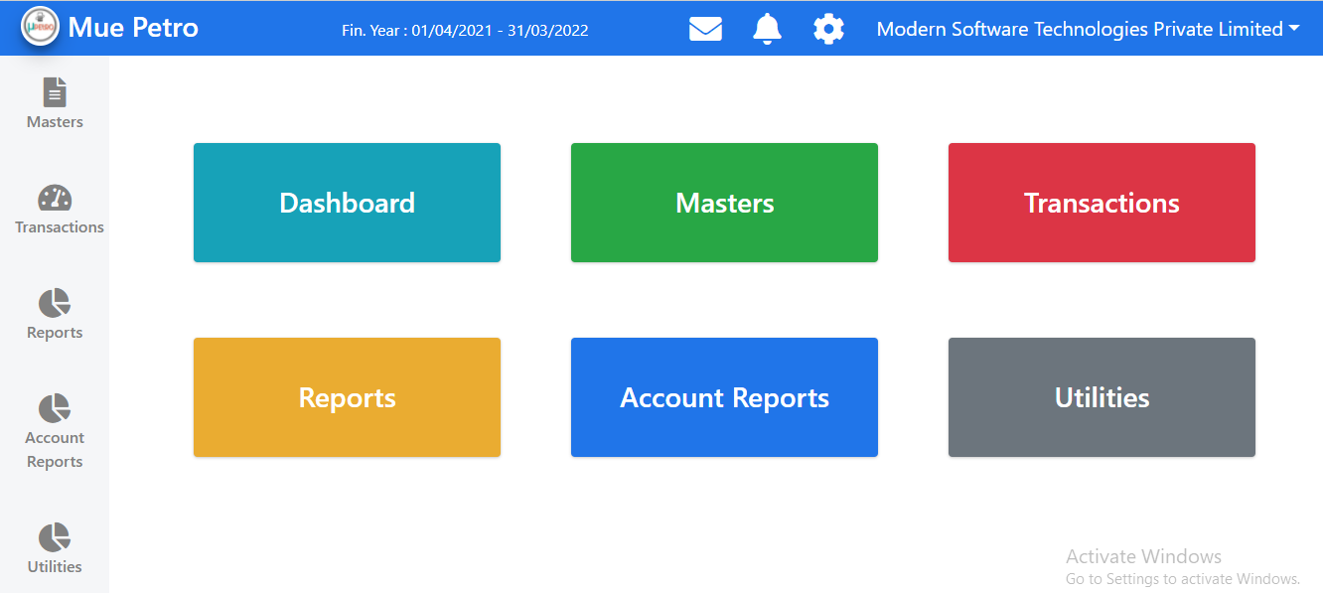

Slide 10
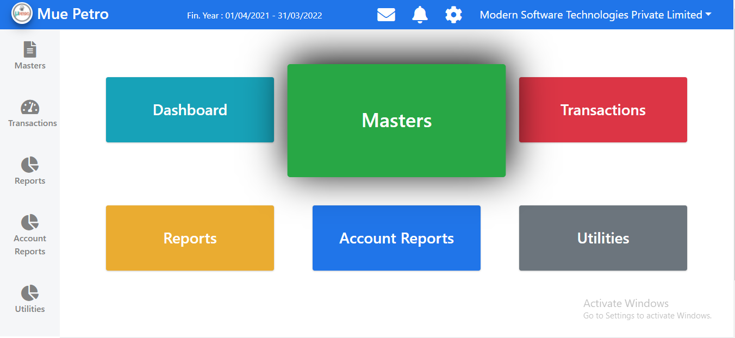

Slide 11
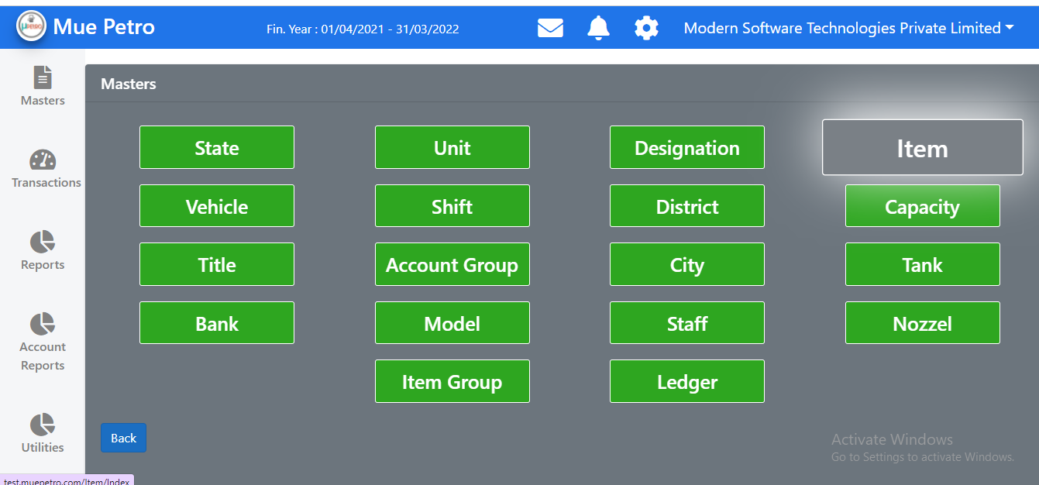

Slide 12
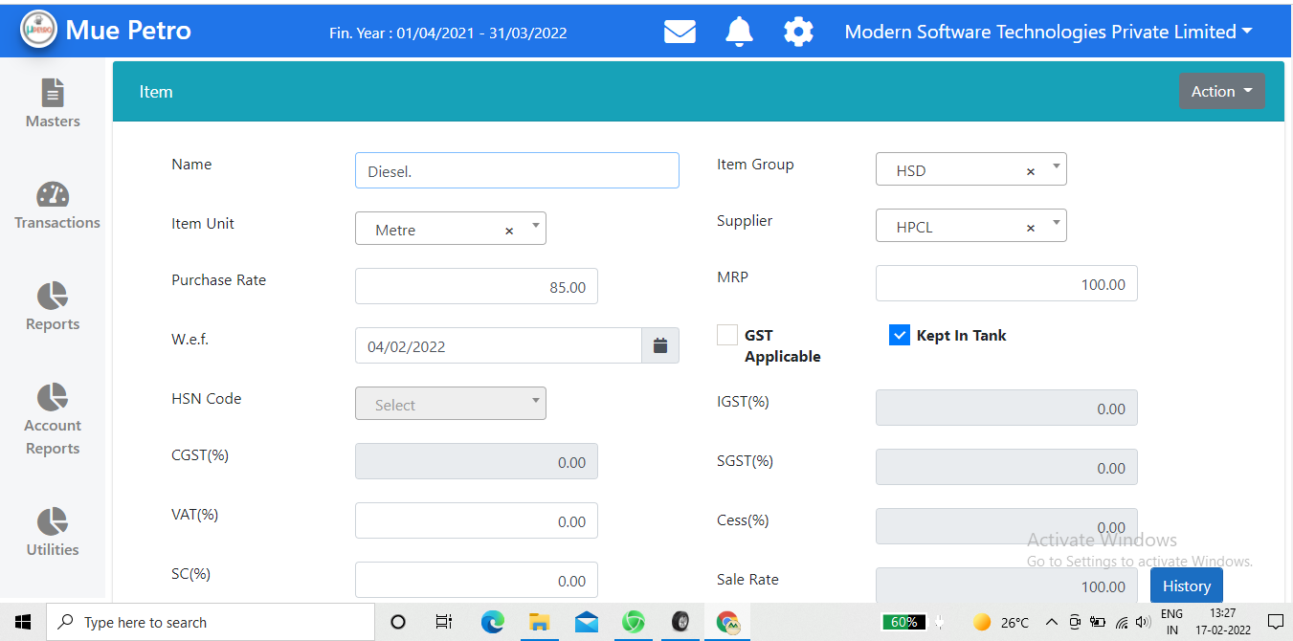

Slide 13
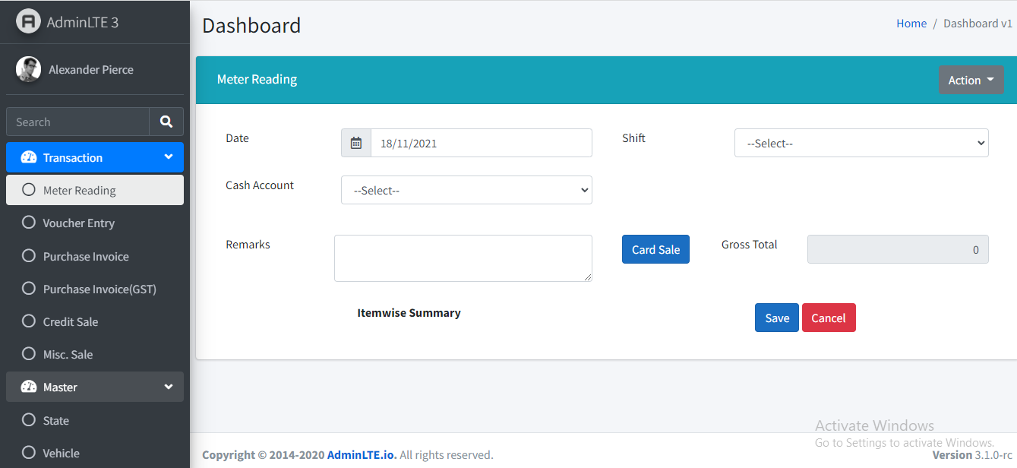

Slide 14
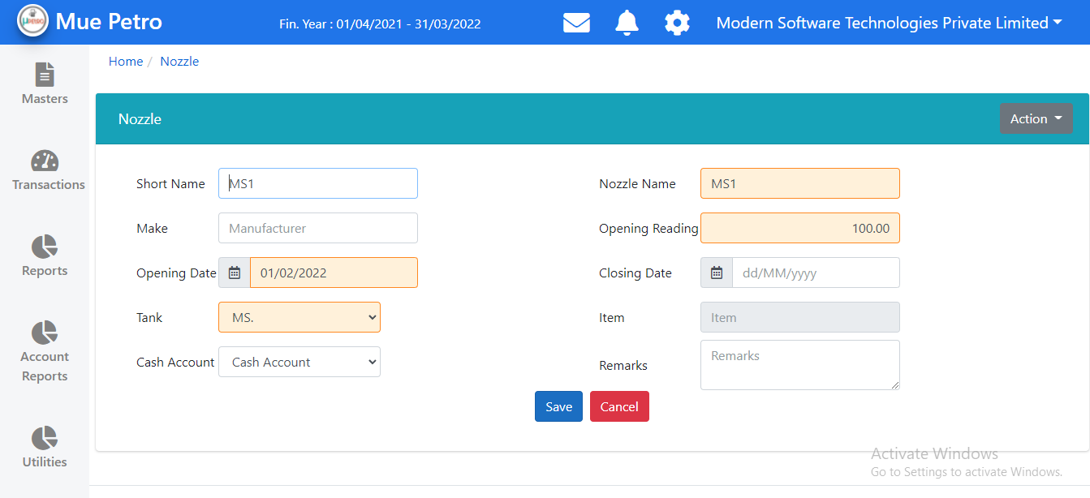

Slide 15
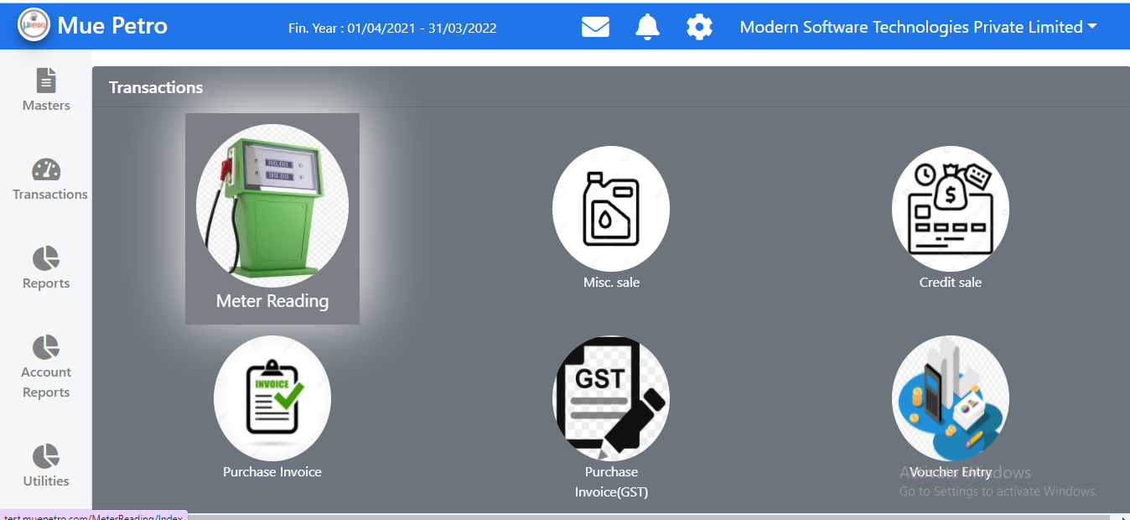

Slide 16
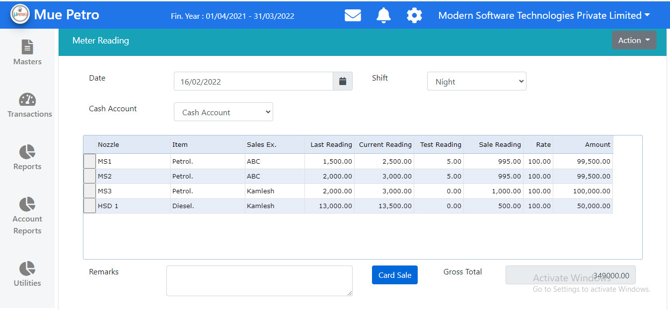

Slide 17
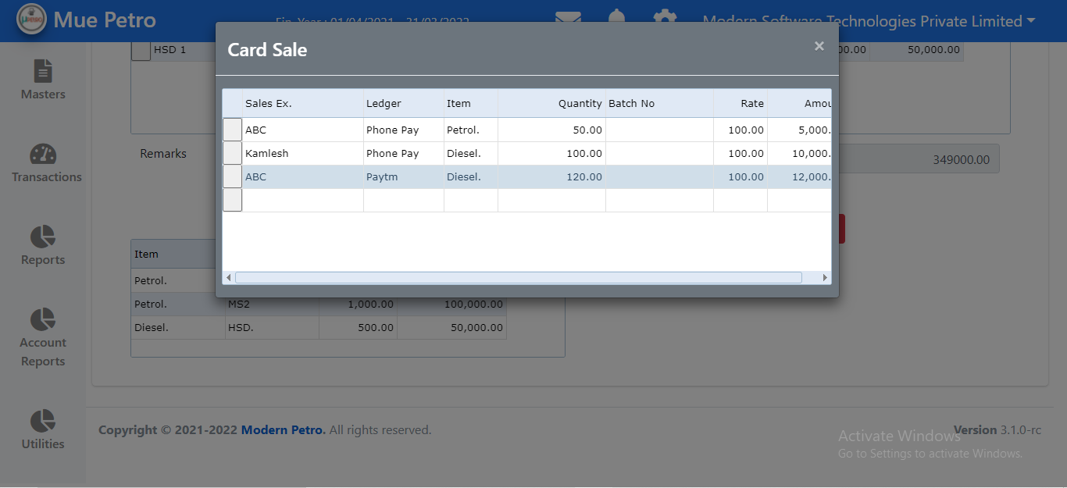

Slide 18
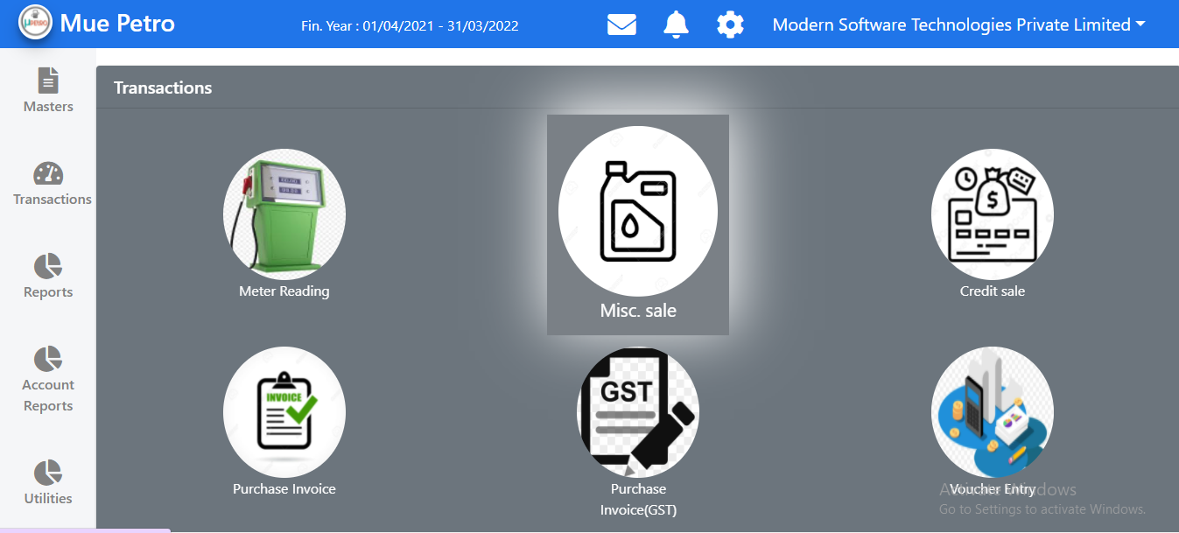

Slide 19
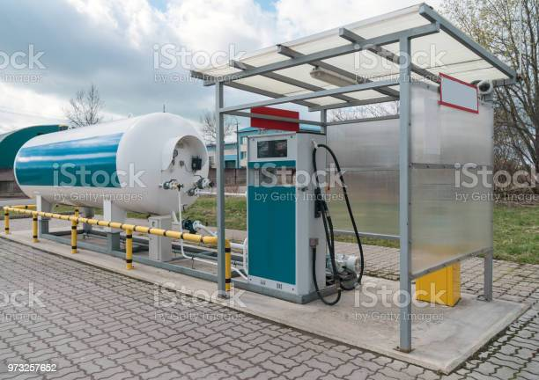
Stock Reports
Physical & As Per Books.
Item Wise Closing Stock.
Stock Summary.
Items Below Re-Order Level.

Slide 20
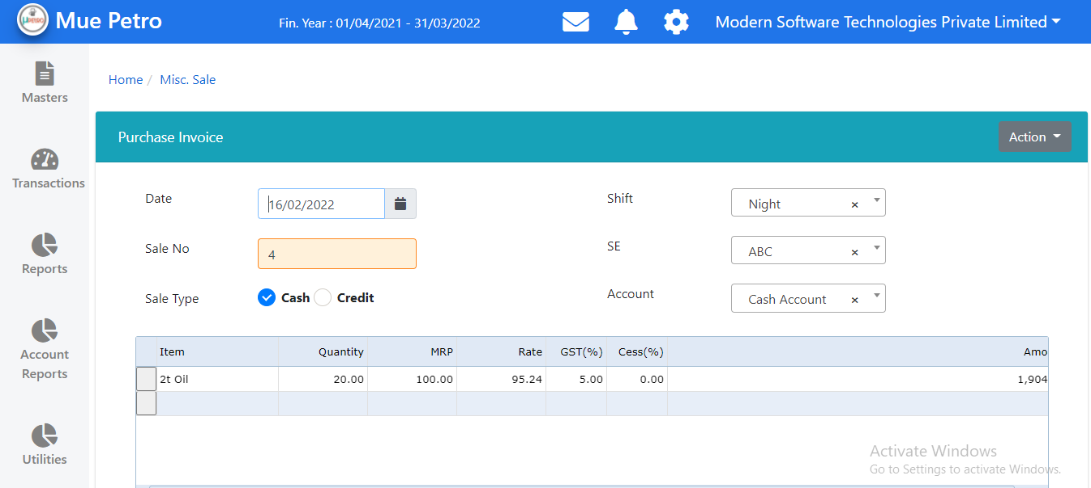

Slide 21

Sales Reports
Sale Chillan Register.
Sale Register.
Item Group Wise.
Party/ Item wise.
Item/ Party Wise.
Sales Executive wise.
Credit Sale Statement.

Slide 22
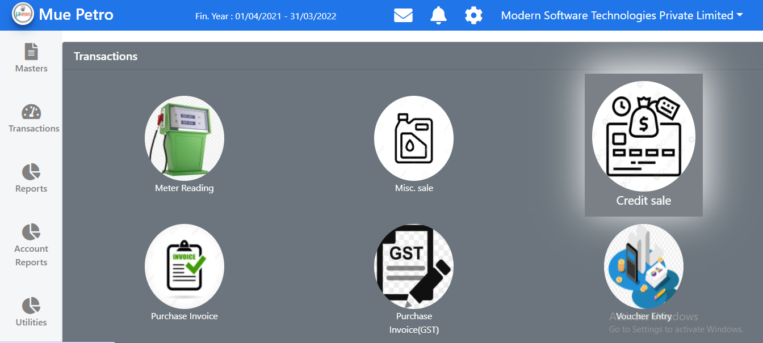

Slide 23
Purchase Reports
Purchase Challan Register.
Purchase Register.
Bill Wise.
Party/ Item wise.
Item/Party wise.
MOQ (Minimum Order Quantity System)

Slide 24
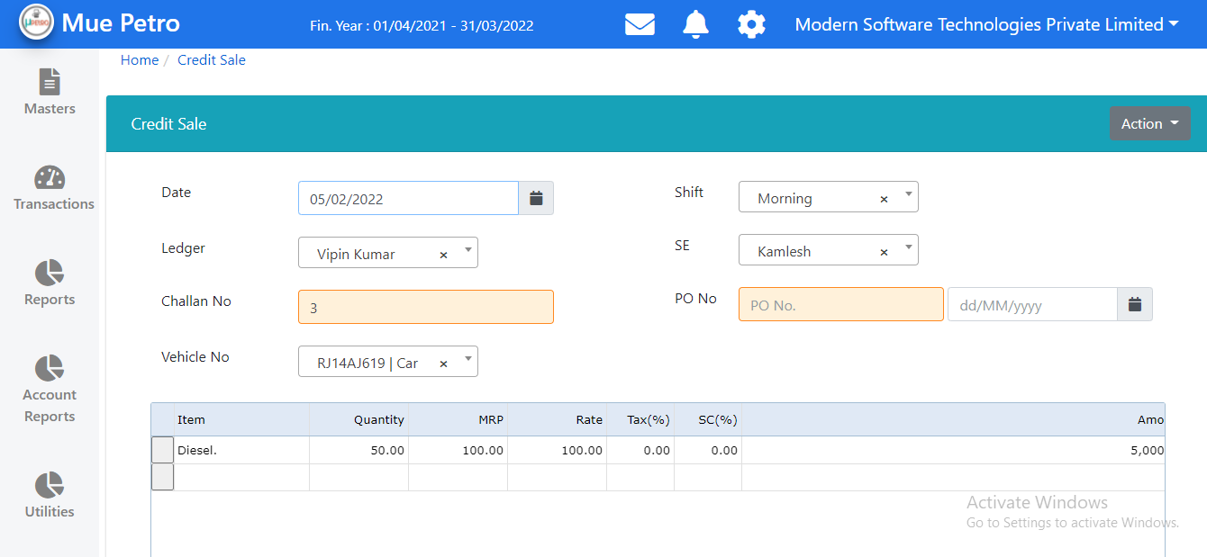

Slide 25
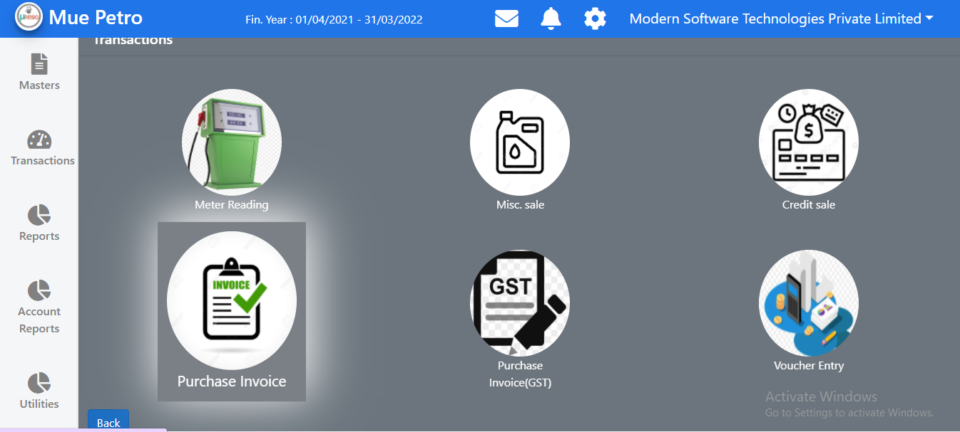

Slide 26
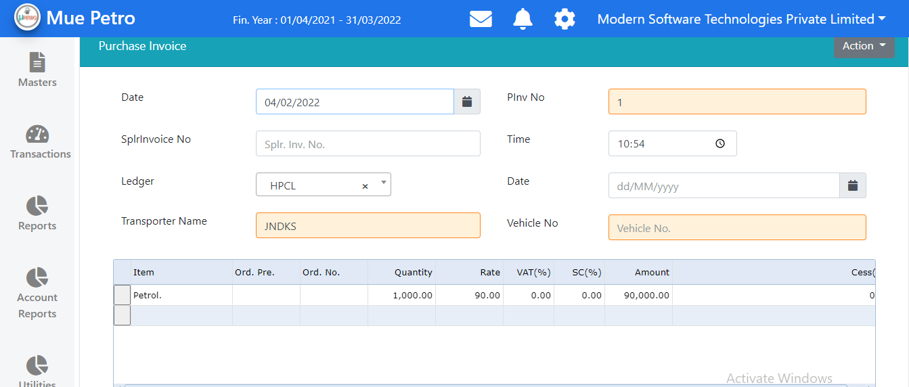

Slide 27
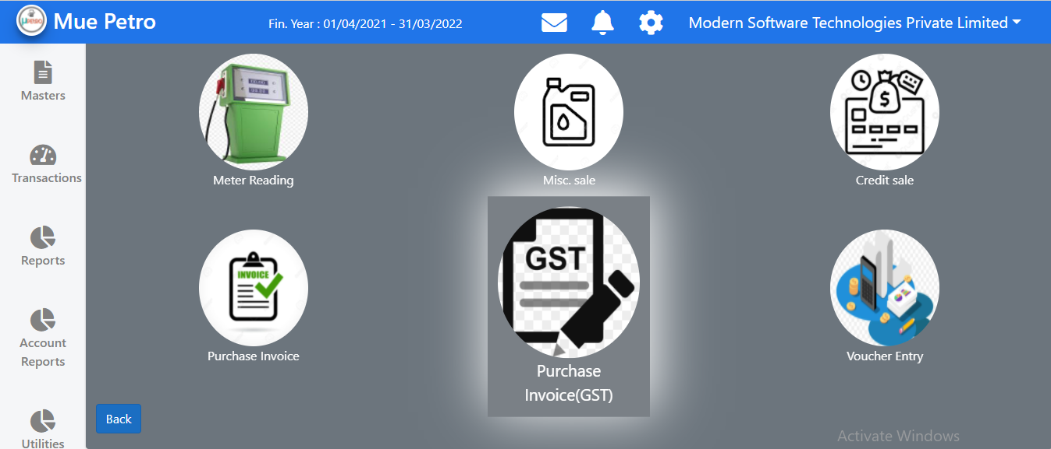

Slide 28
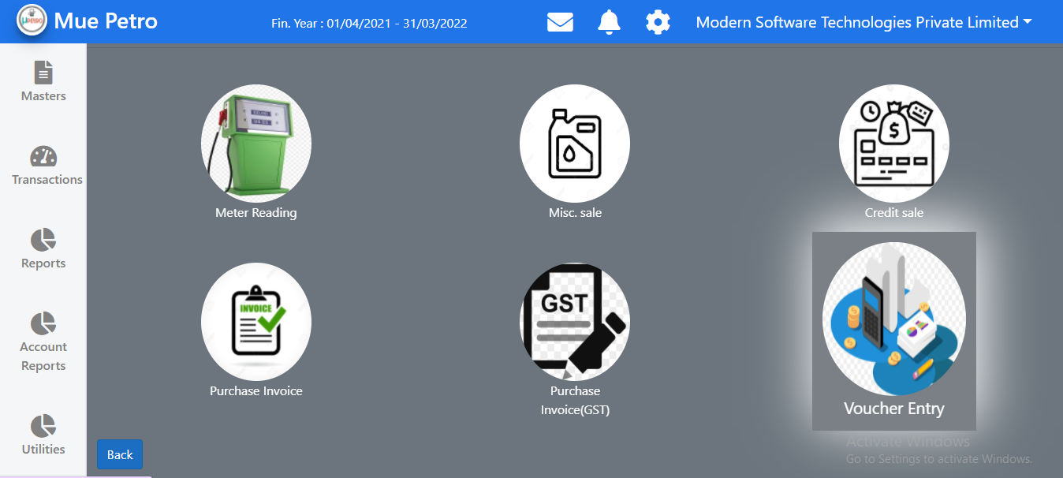

Slide 29
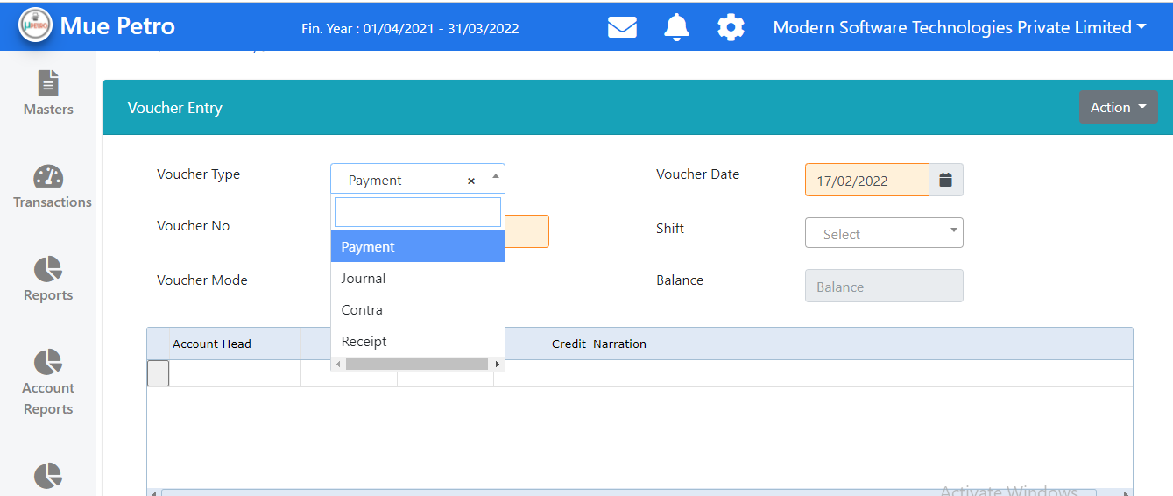

Slide 30
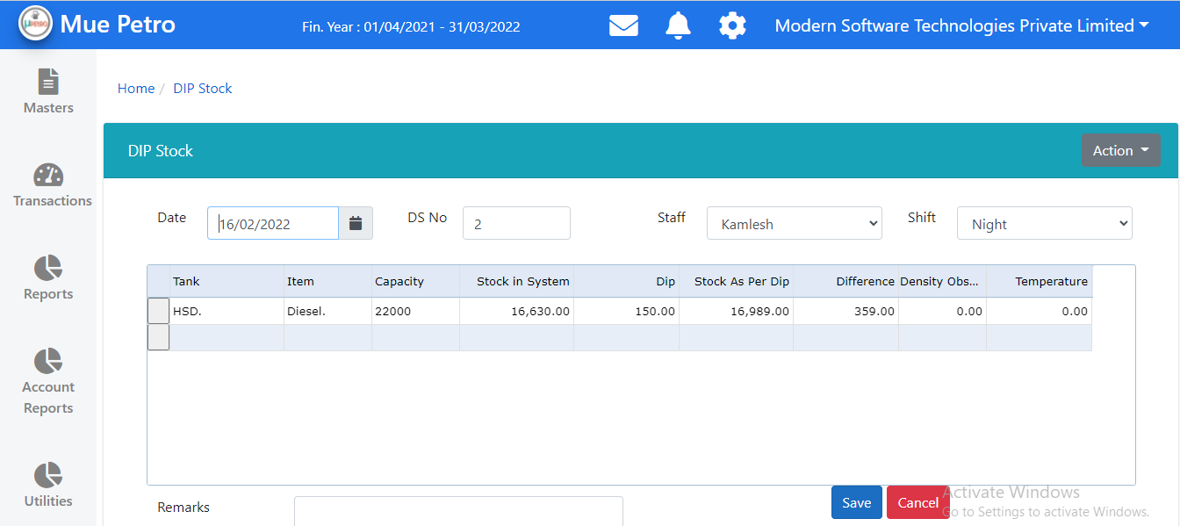

Slide 31
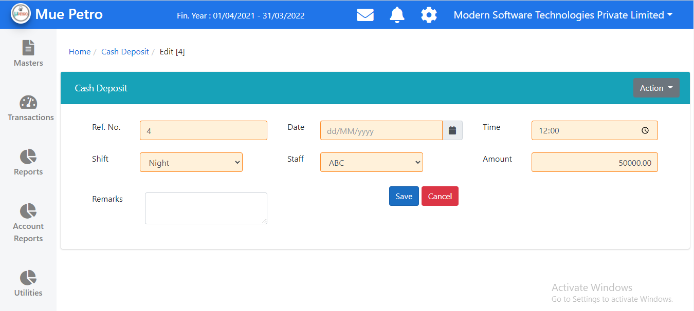

Slide 32
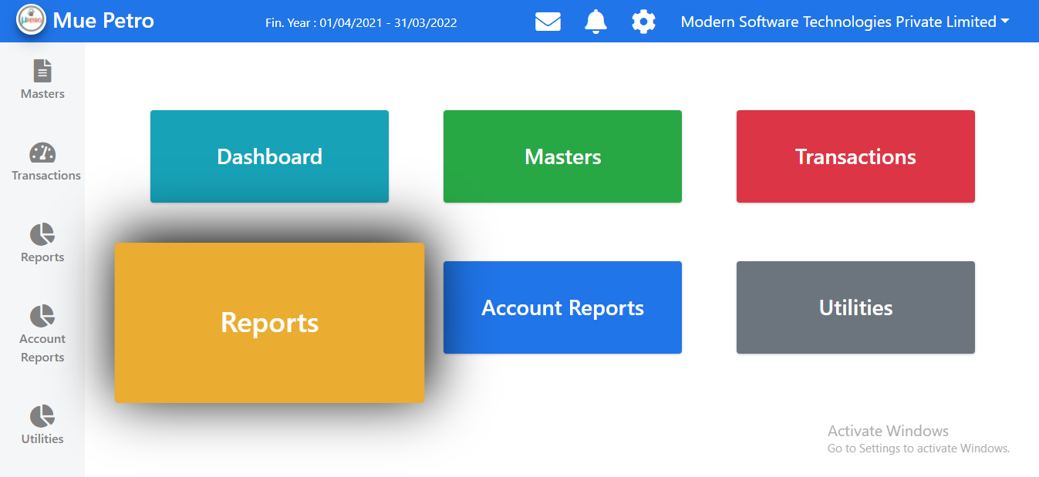

Slide 33
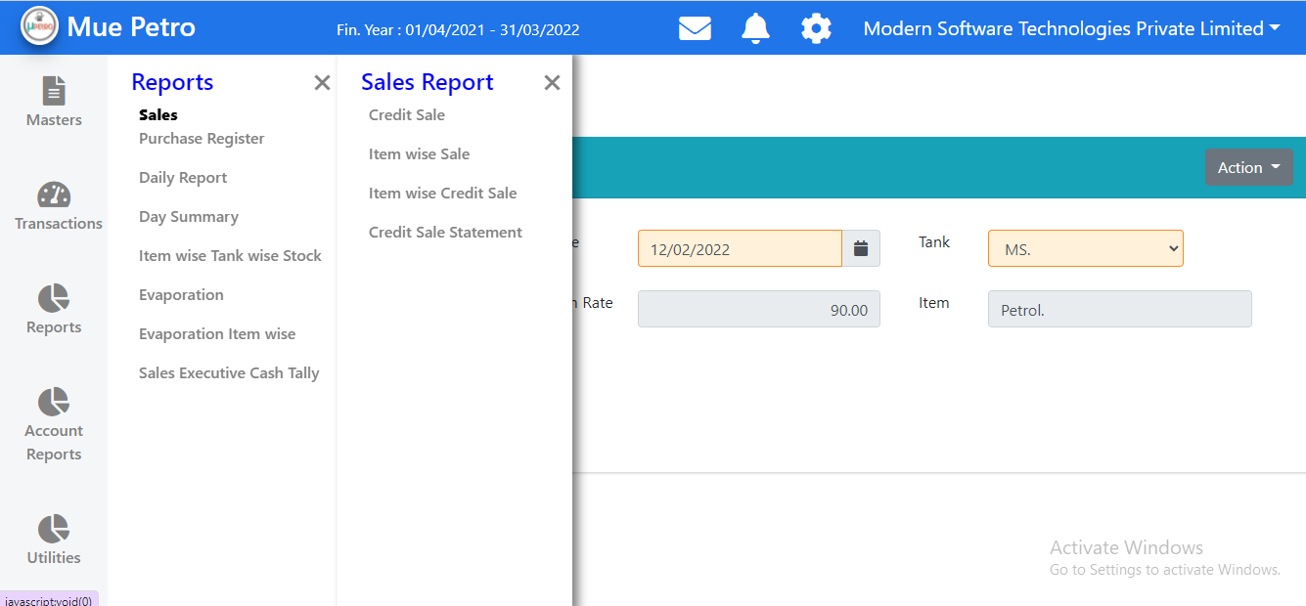

Slide 34
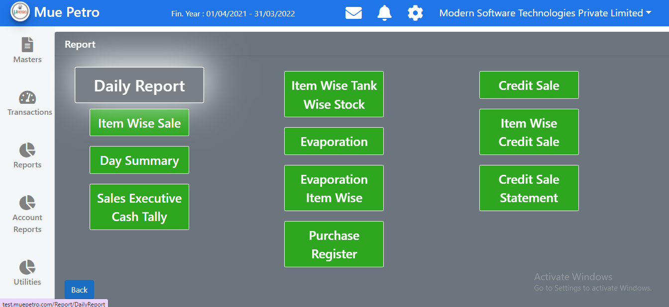

Slide 35
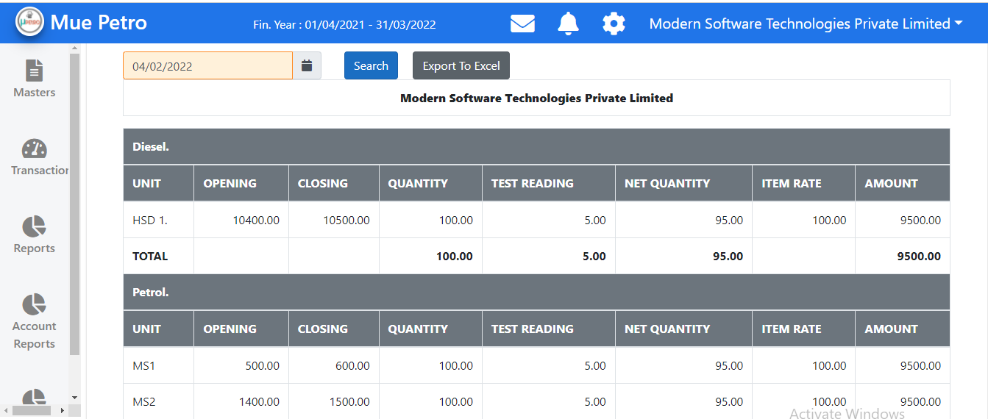

Slide 36
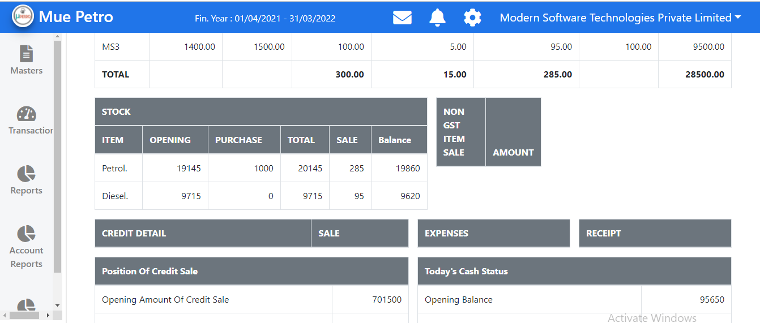

Slide 37
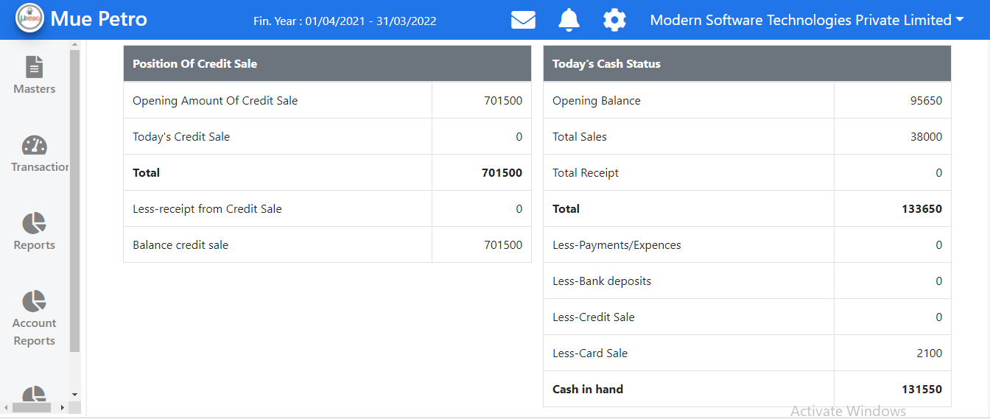

Slide 38
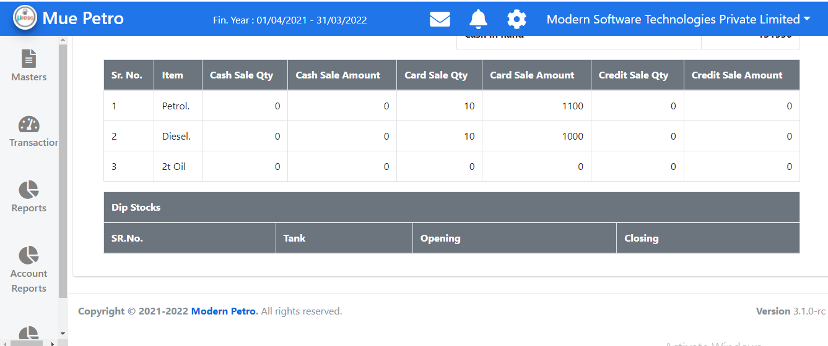

Slide 39
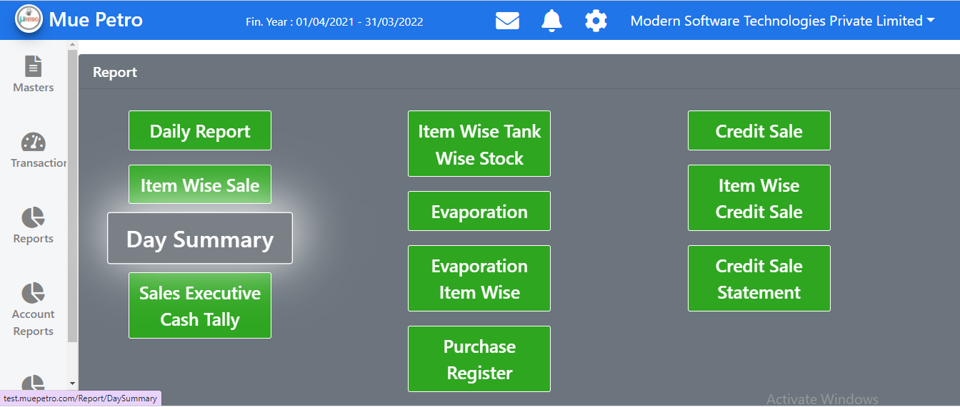

Slide 40
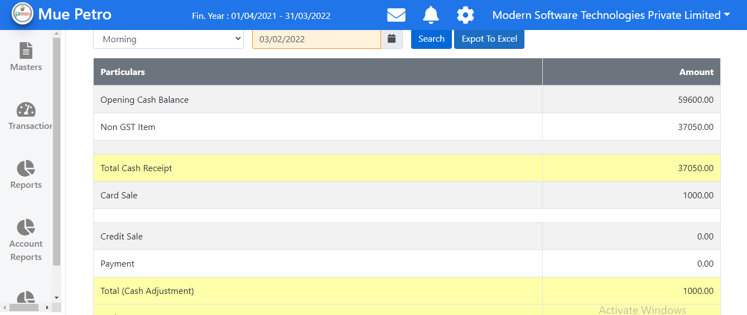

Slide 41
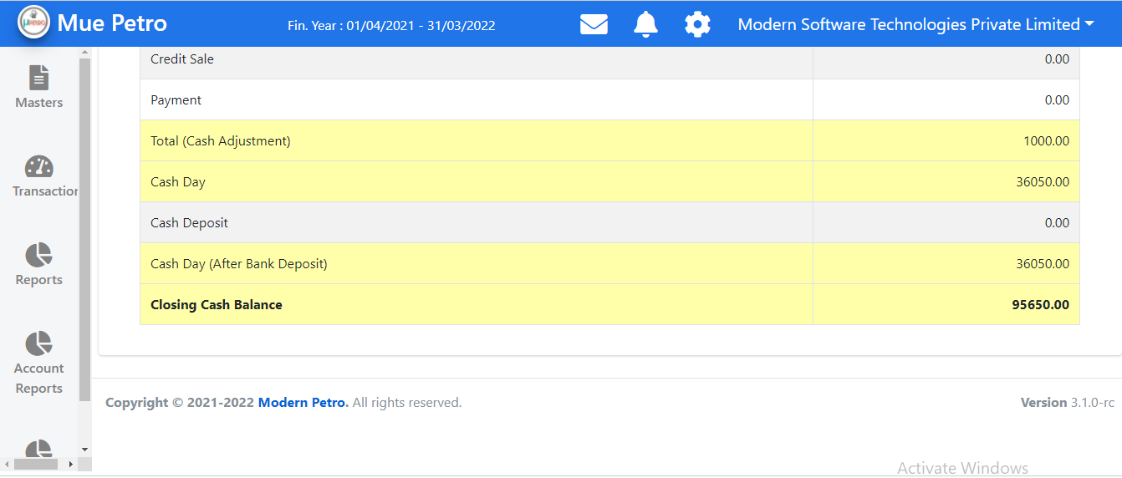

Slide 42
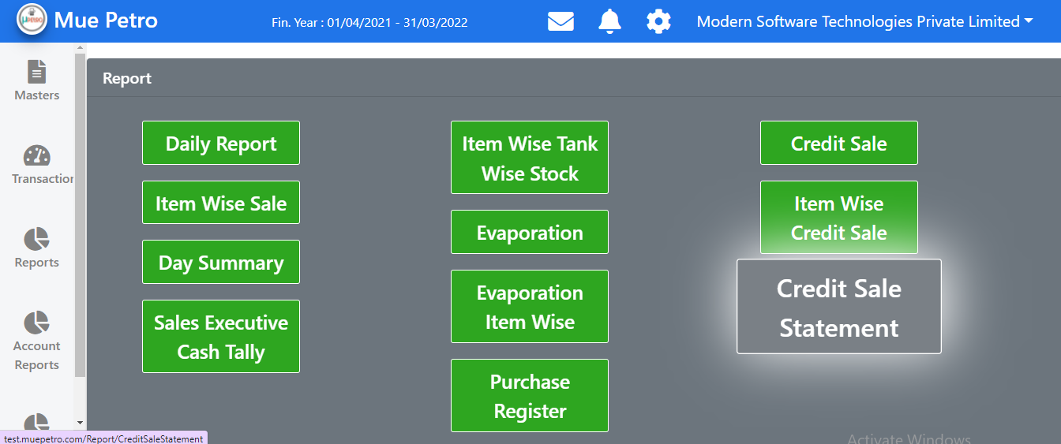

Slide 43
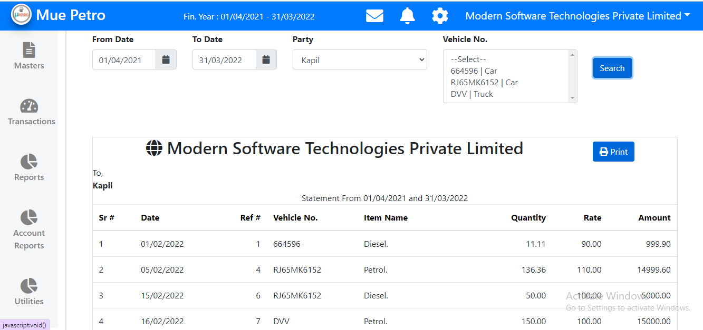

Slide 44
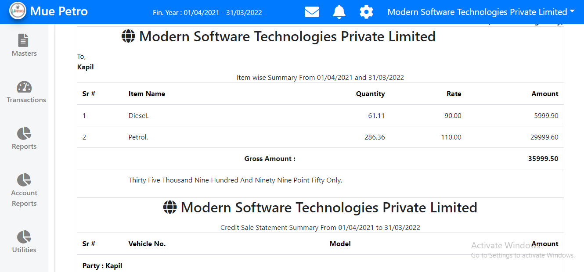

Slide 45
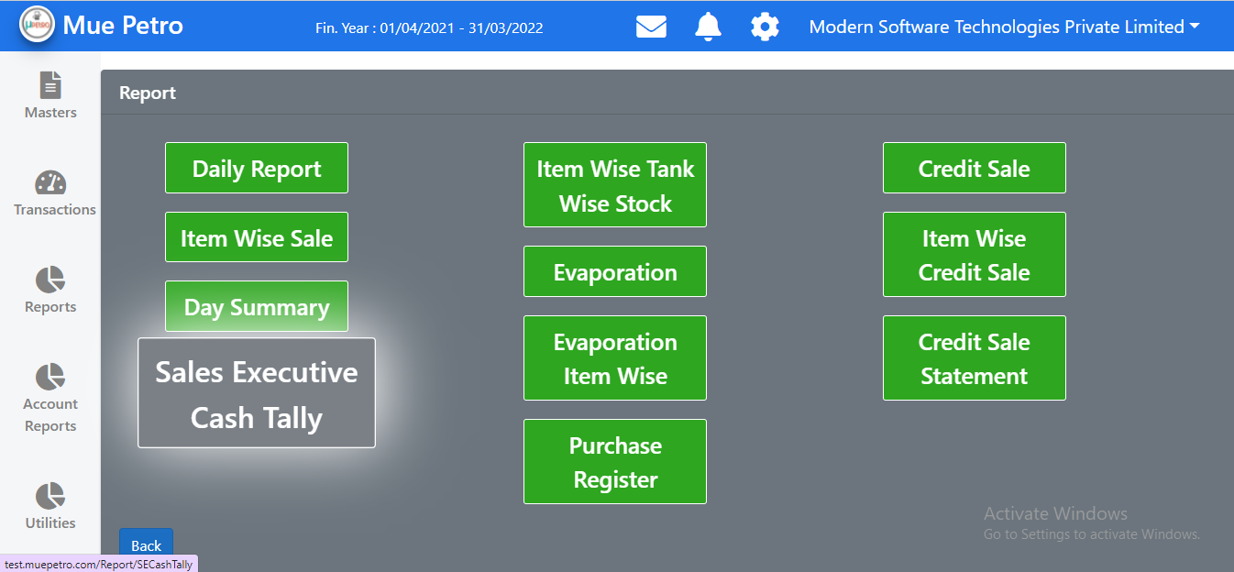

Slide 46
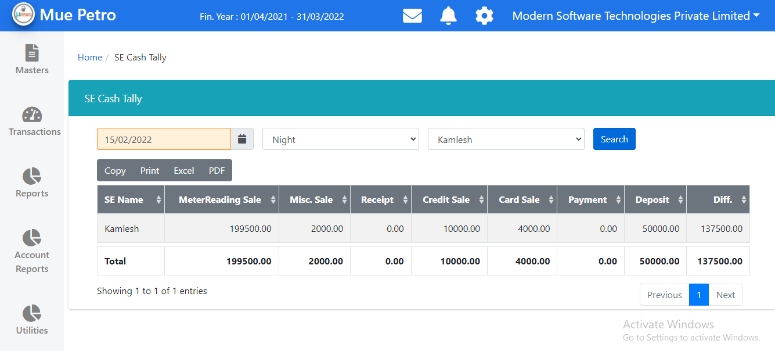

Slide 47
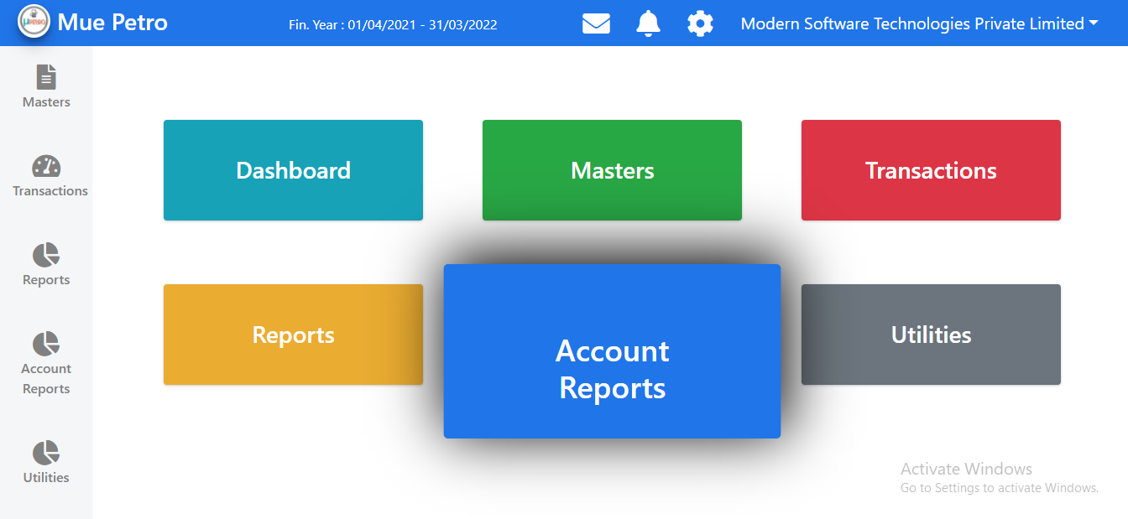

Slide 48
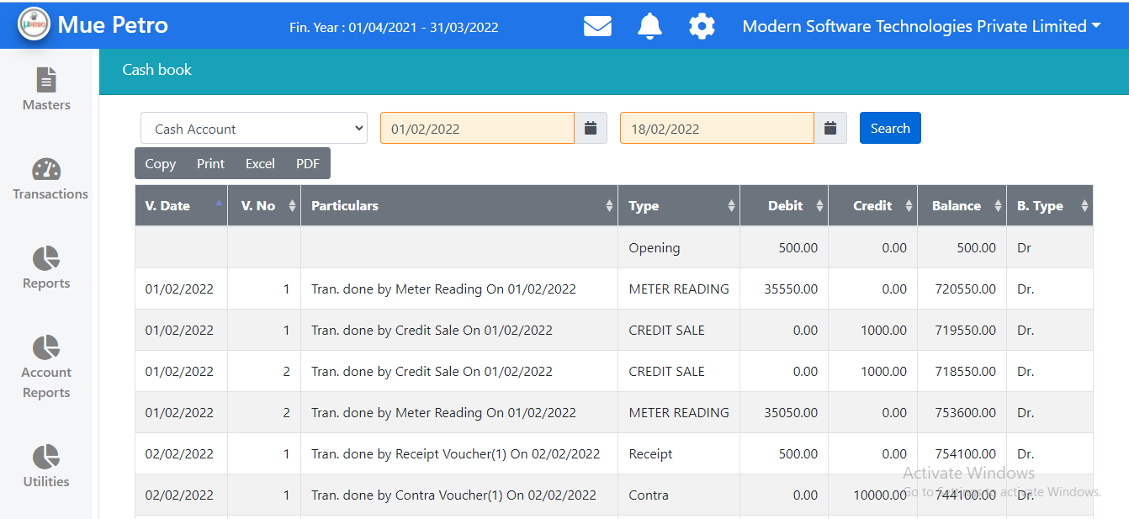

Slide 49
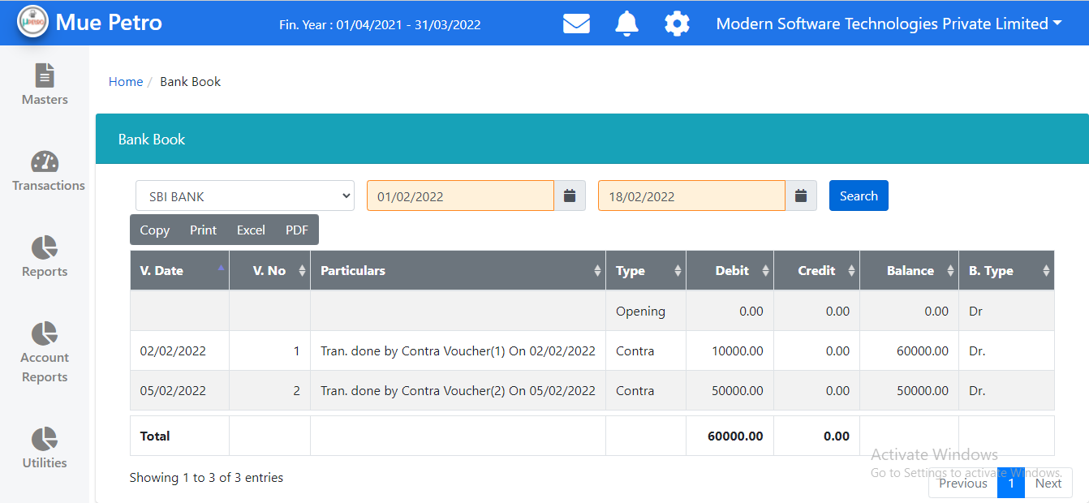

Slide 50
